Slide 1
tip ddr rtl v0 - data doubler RTL test connection
University of ulsan
Electronical, Electronic and Computer Engineering
Jaehyeok Cho

Slide 2
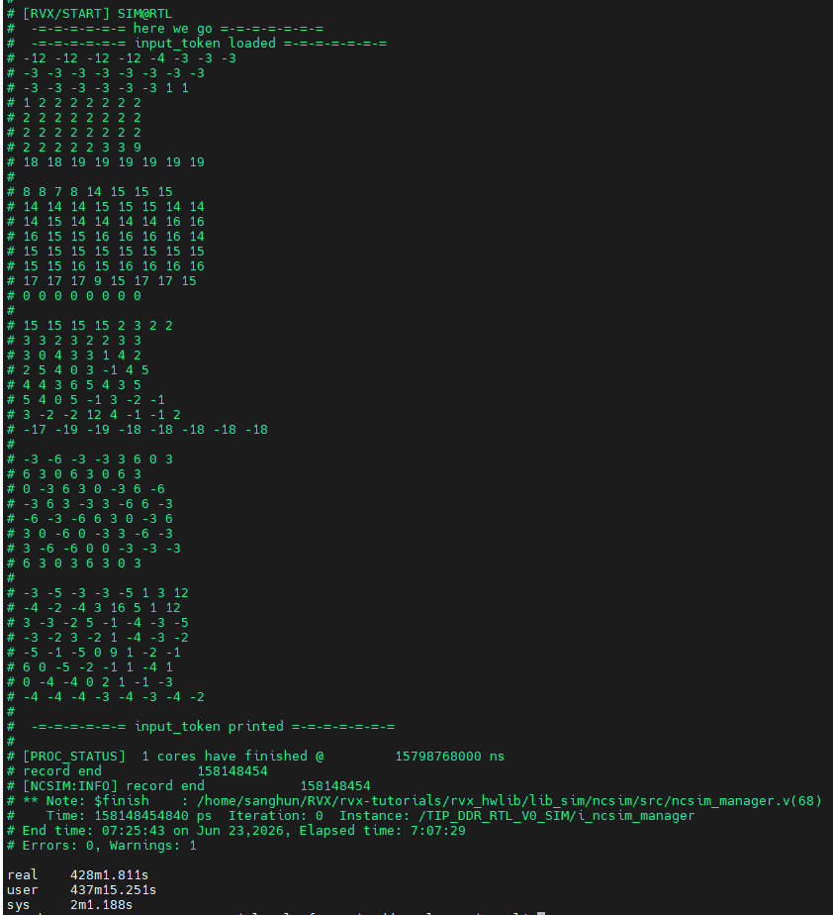
ModelSim simulation
By following the tutorial and make file description, the below command can make waveform file named, vsim.wlf
$ make {target_app}.debug
It takes long time to generate vsim.wlf
It takes almost 7 hours to generate it.
$ time make drv00.debug

Slide 3
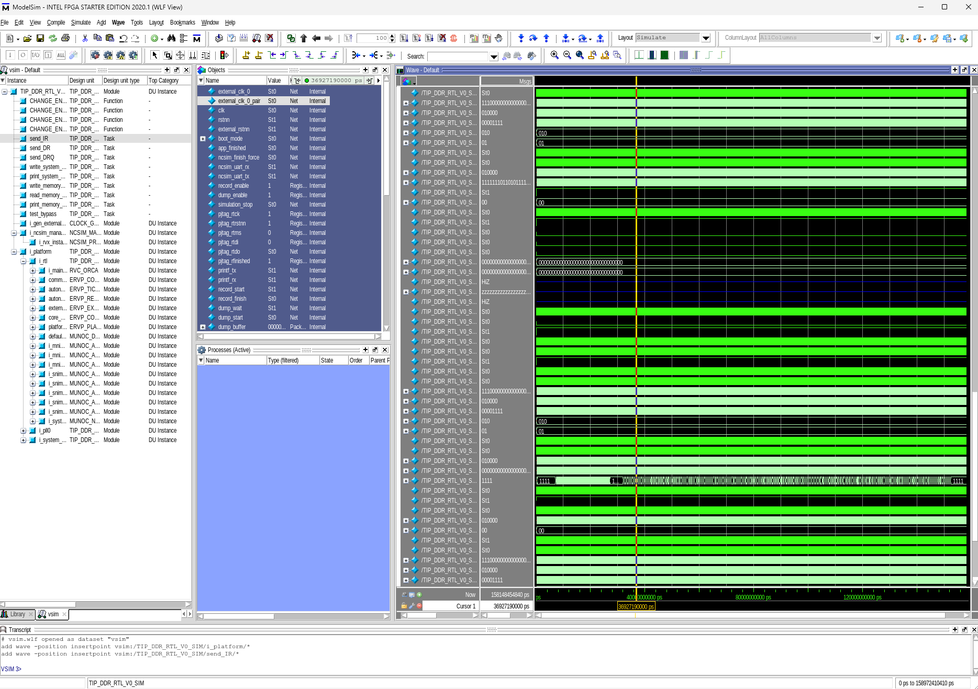
ModelSim launch
I can launch ModelSim waveform with the command below
$ cd sim_rtl $ vsim –view vsim.wlf
ModelSim result

Slide 4
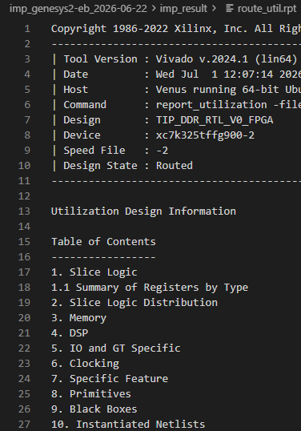
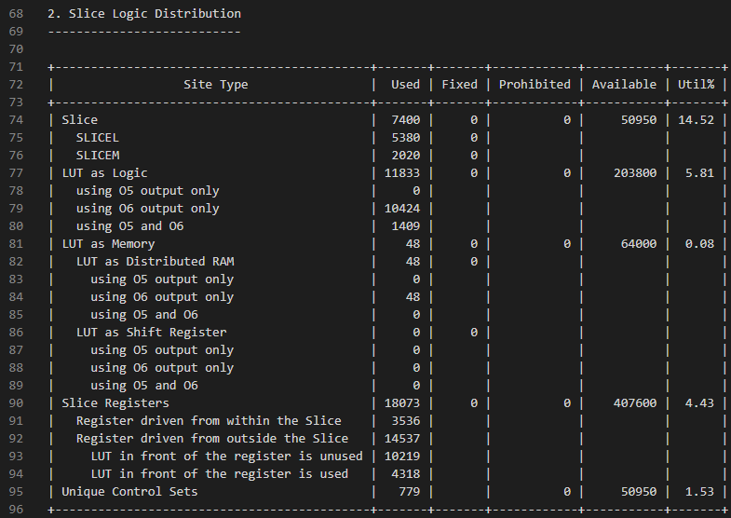
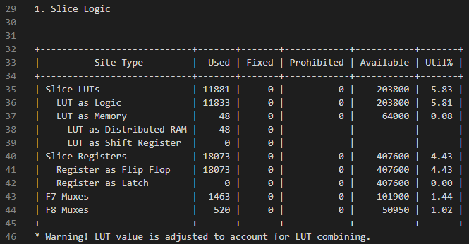
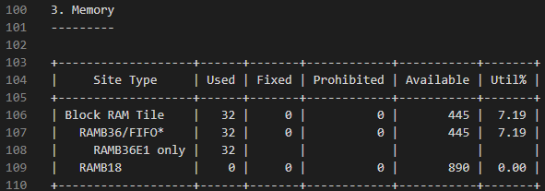
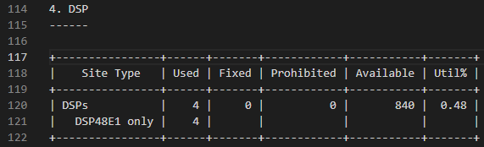
Vivado report
I can check report by opening route_util.rpt
Vivado report

Slide 5
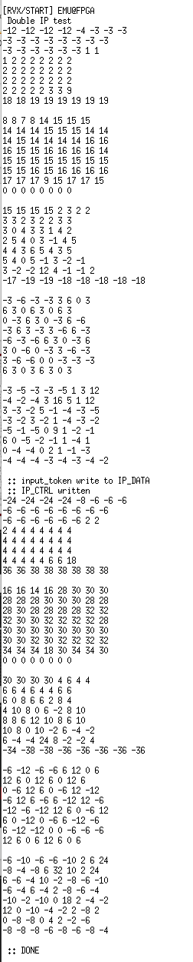
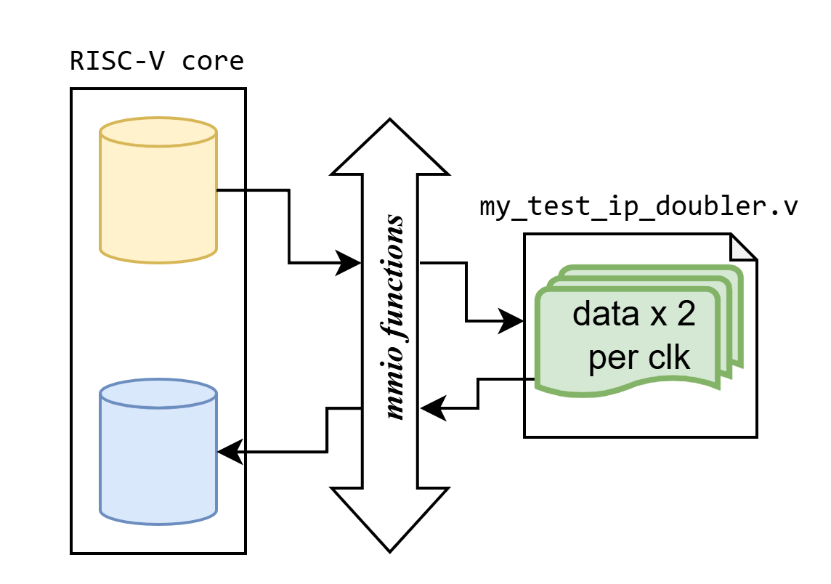
Test doubler module
I planned to make a communication test module between RISC-V and RTL.
RISC-V gives RTL a bunch of data
RTL doubles each data per clock and return it when RISC-V request & Data Ready
The implementation successfully works.
x2
Planned Diagram
Result

Slide 6
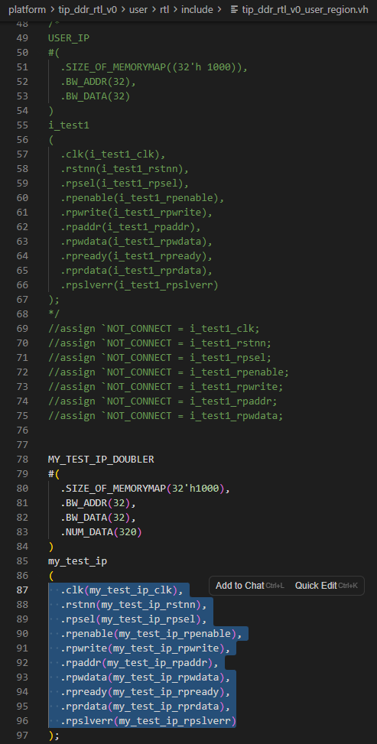
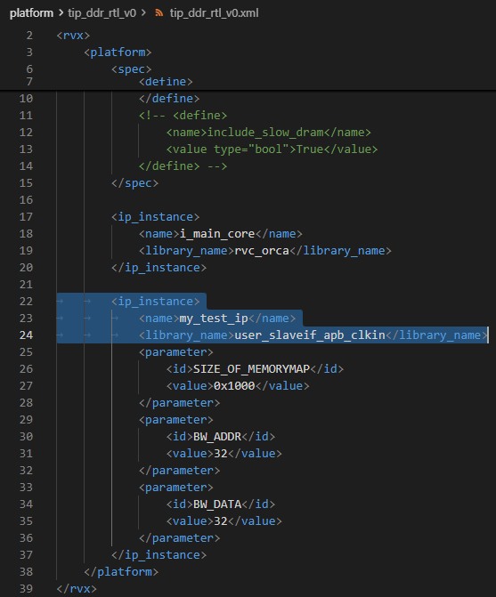
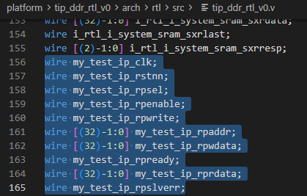
Connection between platform and RTL
When I setup platform-xml file and $make syn, it generates {platform}.v.
I can look up and fill out appropriate parameters to RTL header file named {platform}_user_region.vh with following the examples.
make syn
How I get the parameters
Parameters setup

Slide 7
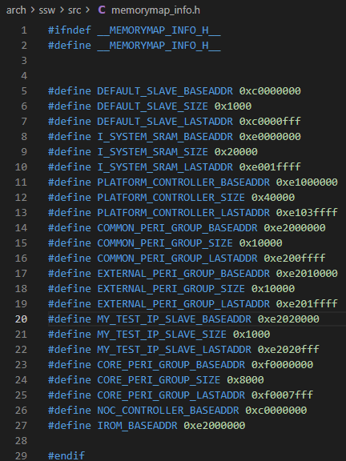
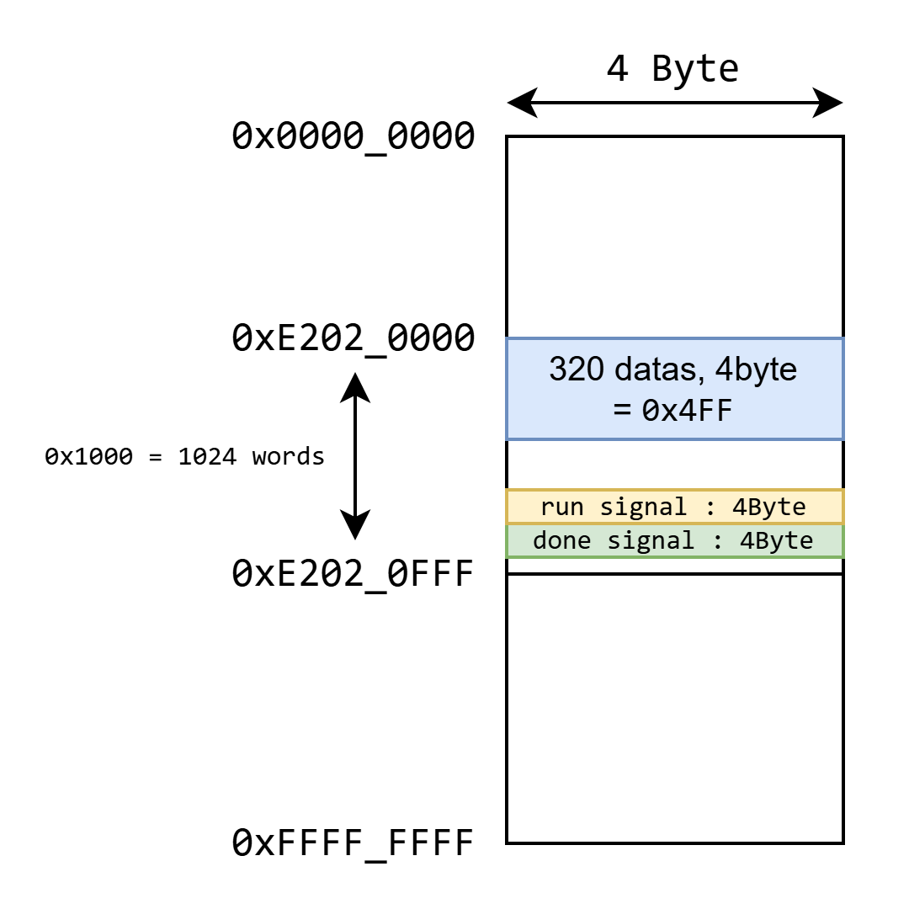
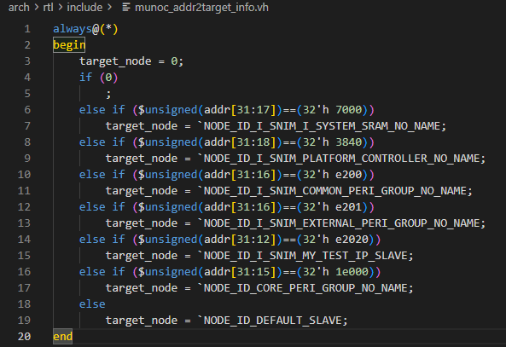
Address Map check
The system provides address map for me to adjust which addr is allocated
Default IP address starts from 0x E202 0000 to 0x E202 0FFF.
It means, I can utilize 1024 words as a default.
Provided Memory Map
Makefile generates the Addr parser
Addr Map that I draw

Slide 8
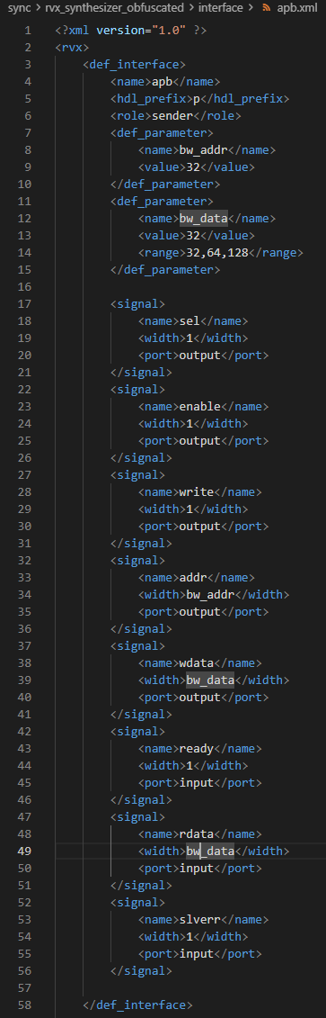
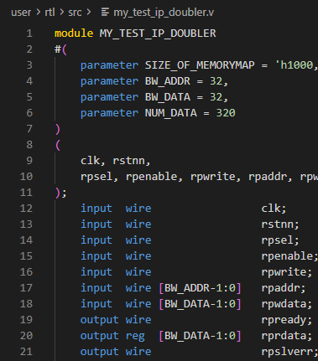
APB protocol connection
The default system support APB connection.
sel, enable, write, addr, wdata
ready, rdata, slverr
RTL Doubler
Port names

Slide 9
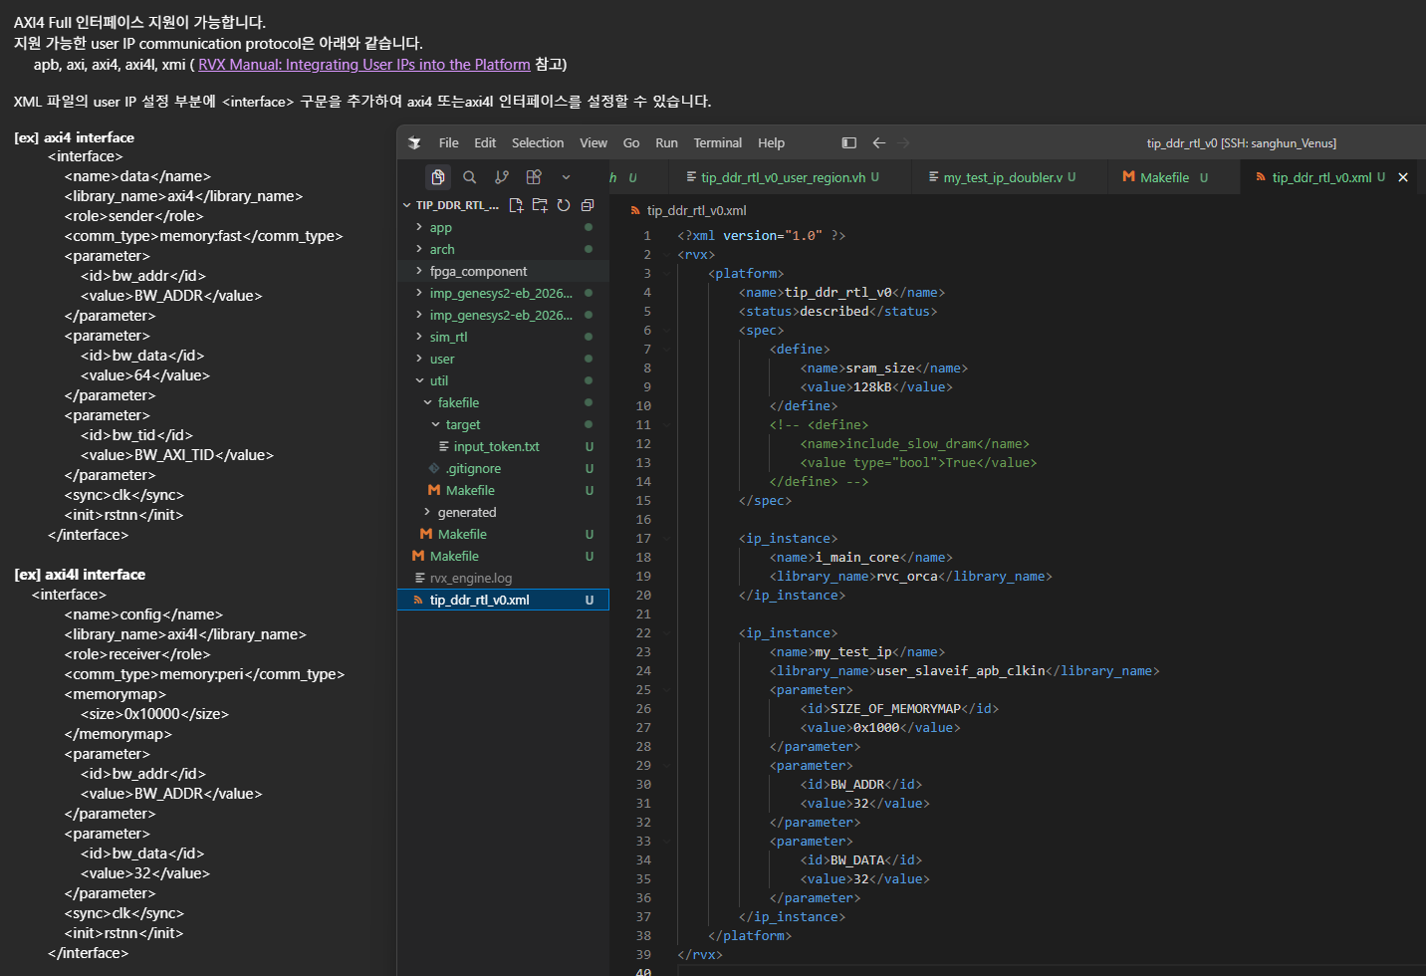
Updated information

Slide 10
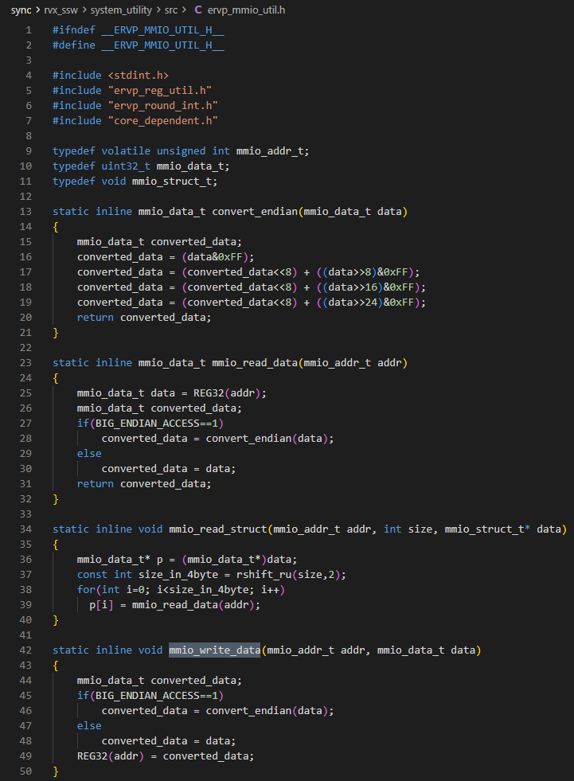
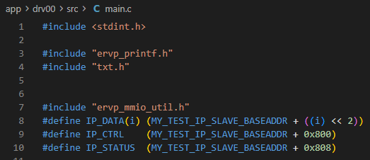
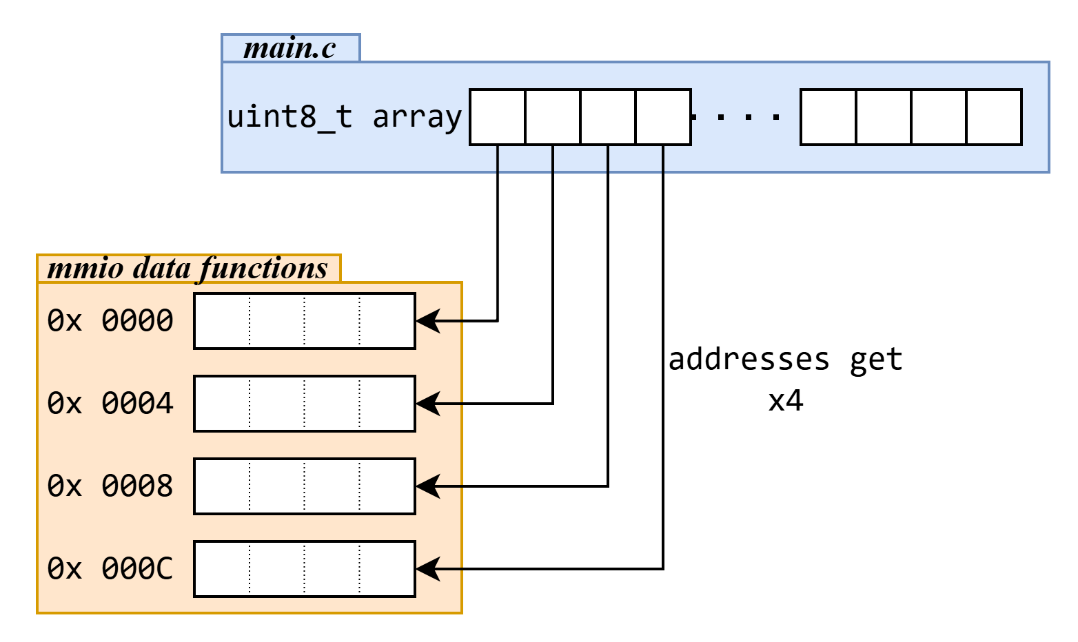
RISC-V communication with RTL
RISC-V can handle mmio with provided functions.
The system aligns Addr and Data in uint32_t format.
Even if each data is uint8_t type, I must be aligned to 32bit.
MMIO usage in C
MMIO functions

Slide 11
Compile and Run CMDs
I can verify the system if it works or not by compiling and running them with commands below.
The result turned out exactly as I expected.
$ cd imp_genesys2-be_2026-06-22 $ make imp 또는 make reimp $ make program $ make drv00.all
The sequence of the commands
Result

Slide 12
Whole codes
University of ulsan
Electronical, Electronic and Computer Engineering
Jaehyeok Cho

Slide 13
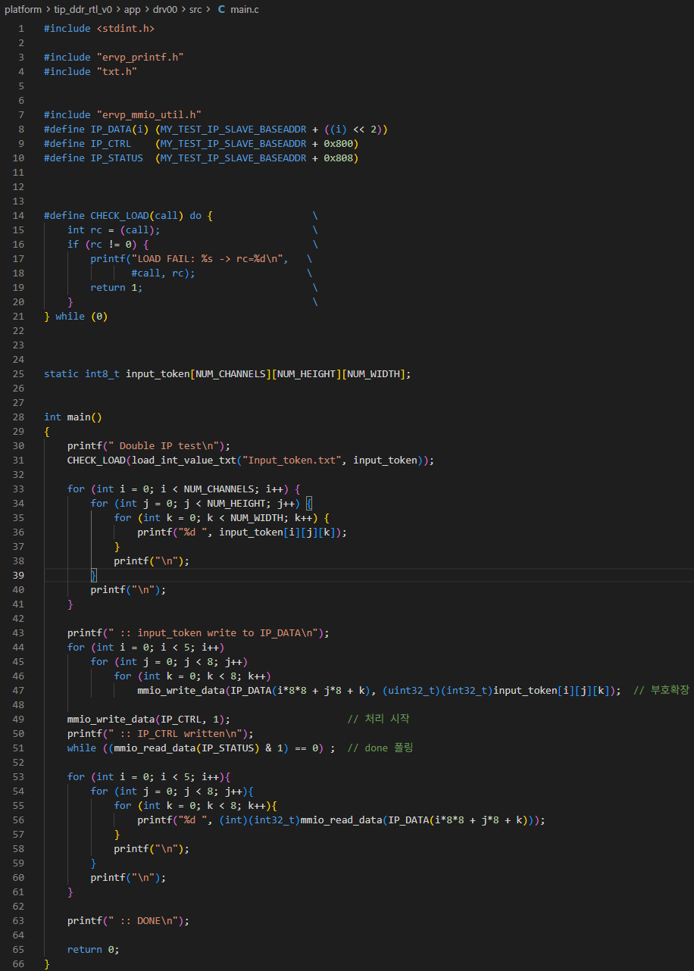
#include <stdint.h> #include "ervp_printf.h“ #include "txt.h“ #include "ervp_mmio_util.h“ #define IP_DATA(i) (MY_TEST_IP_SLAVE_BASEADDR + ((i) << 2)) #define IP_CTRL (MY_TEST_IP_SLAVE_BASEADDR + 0x800) #define IP_STATUS (MY_TEST_IP_SLAVE_BASEADDR + 0x808) #define CHECK_LOAD(call) do { \ int rc = (call); \ if (rc != 0) { \ printf("LOAD FAIL: %s -> rc=%d\n", \ #call, rc); \ return 1; \ } \ } while (0) static int8_t input_token[NUM_CHANNELS][NUM_HEIGHT][NUM_WIDTH]; int main() { printf(" Double IP test\n"); CHECK_LOAD(load_int_value_txt("Input_token.txt", input_token)); for (int i = 0; i < NUM_CHANNELS; i++) { for (int j = 0; j < NUM_HEIGHT; j++) { for (int k = 0; k < NUM_WIDTH; k++) { printf("%d ", input_token[i][j][k]); } printf("\n"); } printf("\n"); } printf(" :: input_token write to IP_DATA\n"); for (int i = 0; i < 5; i++) for (int j = 0; j < 8; j++) for (int k = 0; k < 8; k++) mmio_write_data(IP_DATA(i*8*8 + j*8 + k), (uint32_t)(int32_t)input_token[i][j][k]); // 부호확장 mmio_write_data(IP_CTRL, 1); // 처리 시작 printf(" :: IP_CTRL written\n"); while ((mmio_read_data(IP_STATUS) & 1) == 0) ; // done 폴링 for (int i = 0; i < 5; i++){ for (int j = 0; j < 8; j++){ for (int k = 0; k < 8; k++){ printf("%d ", (int)(int32_t)mmio_read_data(IP_DATA(i*8*8 + j*8 + k))); } printf("\n"); } printf("\n"); } printf(" :: DONE\n"); return 0; }

Slide 14
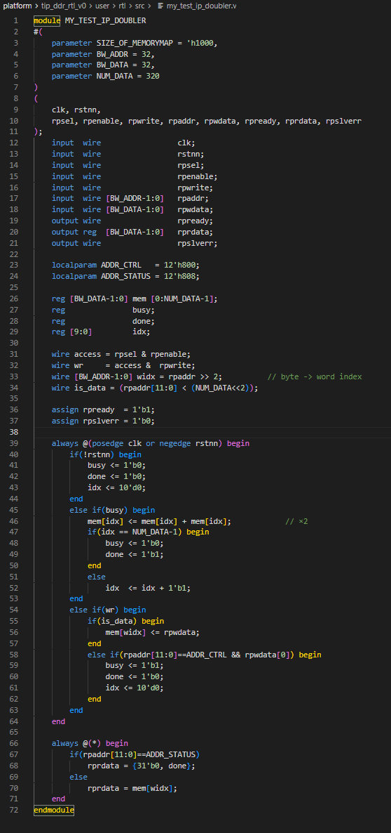
module MY_TEST_IP_DOUBLER
#( parameter SIZE_OF_MEMORYMAP = 'h1000, parameter BW_ADDR = 32, parameter BW_DATA = 32, parameter NUM_DATA = 320 ) ( clk, rstnn, rpsel, rpenable, rpwrite, rpaddr, rpwdata, rpready, rprdata, rpslverr ); input wire clk; input wire rstnn; input wire rpsel; input wire rpenable; input wire rpwrite; input wire [BW_ADDR-1:0] rpaddr; input wire [BW_DATA-1:0] rpwdata; output wire rpready; output reg [BW_DATA-1:0] rprdata; output wire rpslverr;
localparam ADDR_CTRL = 12'h800; localparam ADDR_STATUS = 12'h808; reg [BW_DATA-1:0] mem [0:NUM_DATA-1]; reg busy; reg done; reg [9:0] idx; wire access = rpsel & rpenable; wire wr = access & rpwrite; wire [BW_ADDR-1:0] widx = rpaddr >> 2; // byte -> word index wire is_data = (rpaddr[11:0] < (NUM_DATA<<2)); assign rpready = 1'b1; assign rpslverr = 1’b0; always @(posedge clk or negedge rstnn) begin if(!rstnn) begin busy <= 1'b0; done <= 1'b0; idx <= 10’d0; end else if(busy) begin mem[idx] <= mem[idx] + mem[idx]; // ×2 if(idx == NUM_DATA-1) begin busy <= 1'b0; done <= 1'b1; end else idx <= idx + 1’b1; end else if(wr) begin if(is_data) begin mem[widx] <= rpwdata; end else if(rpaddr[11:0]==ADDR_CTRL && rpwdata[0]) begin busy <= 1'b1; done <= 1'b0; idx <= 10'd0; end end end always @(*) begin if(rpaddr[11:0]==ADDR_STATUS) rprdata = {31'b0, done}; else rprdata = mem[widx]; end
endmodule

